Slide 1
Task-3
Report
Title- Cross Site Scripting
Domain- Valnewb.com
SubDomain- test.vulnweb.com

Slide 2
Steps-
Step 1: Visit http://testasp.vulnweb.com/
Step 2: On the top menu you will find a search option.
Step 3: Click on it and you will be prompted with the Search box.
Step 4: Now you can find different payloads for XSS.
Step 5: Send the request to the intruder and paste all the payloads.
Step 6: Try to find a successful payload for XSS.
Step 7: Prepare a report for it.
Impact- Cross Site Scrpting Can Lead To Steling Of Your User Data
And It Can Be Harmful For Your Website/Company.

Slide 3
MITIGRATION- If You Want To Prevent Your Website To Be Vulnerable Of
Cross Site Scripting Then You Can Just Enable No Script In Browser.

Slide 4
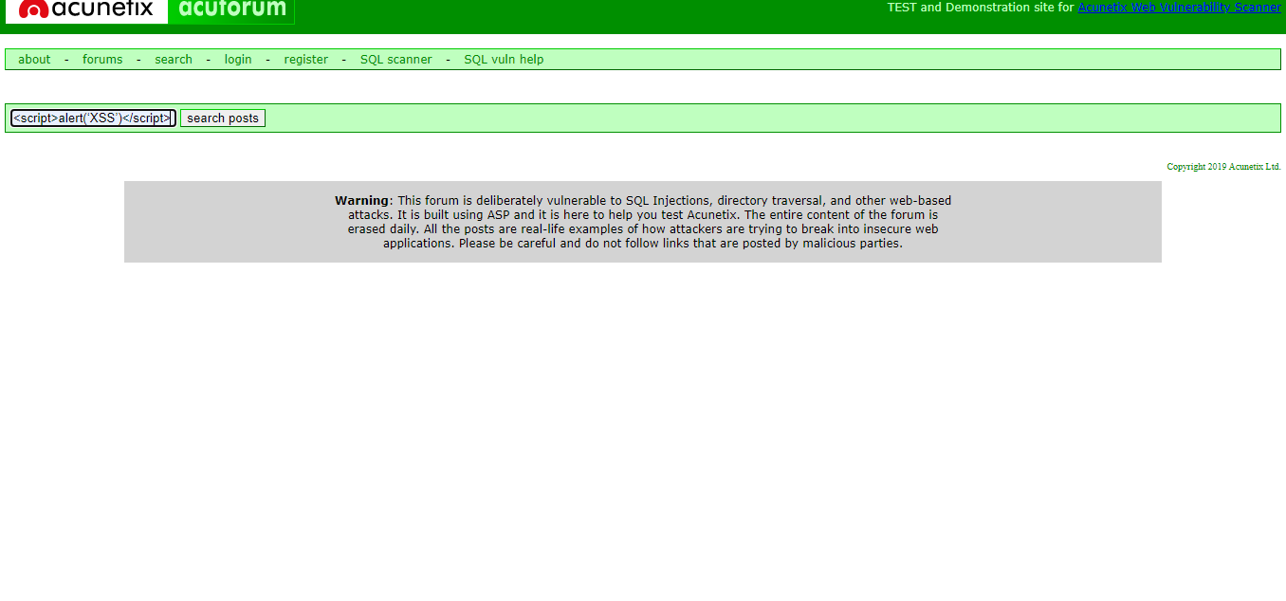
Screenshot-

